Slide 1
Covenants of the Bible

Slide 2
The Covenants
Adam - Dominion and Authority
Noah - Preservation of the earth
Abraham, Isaac, Jacob - Covenant of Faith, Land, and Prosperity
Moses - Marriage Covenant
Part two - Constitution of the Kingdom
David - Kingdom Covenant
Phinehas - Eternal Priesthood
Jesus - New/Renewed Covenant

Slide 3
Progression of the Covenant
Adam - Dominion/Authority to be fruitful and multiply and to manage the Earth (God’s Jewel)
Noah - Preserve the earth from destruction by water
Abraham, Isaac, Jacob - Land, Wealth, Protection
Father of Many Nations will Laugh and Rule as a Prince with God
Moses - Marriage and Constitution of a Kingdom
David - Eternal Kingship over that Kingdom
Pinchas - Eternal Priesthood divided between an earthly priesthood and a heavenly one

Slide 4
Melchizedek Priesthood
Priesthood
Kingship
Firstborn
House of Ephraim
Melchizedek Priesthood

Slide 5
The New Covenant

Slide 6
Why the New Covenant?
The original Covenant
given to Abraham
passed down through Isaac and Jacob
to the 12 tribes of Jacob/Israel
Established at Mount Sinai
all twelve tribes agreed to the Covenant
they “married” their husband, YHVH
But the Covenant (marriage vow) was broken

Slide 7
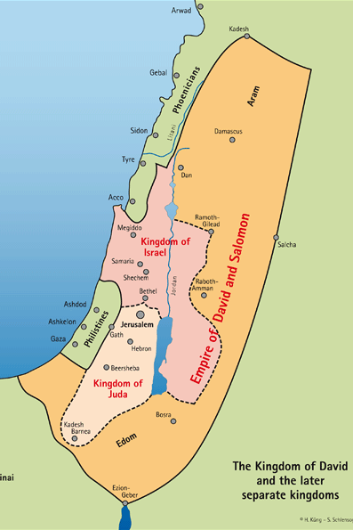
Kingdom of David
Kingdom of God
Kingdom of Heaven
Judged under Solomon
Divided under Rehaboam
Solomon’s son
God’s punishment for disobeying His Covenant

Slide 8
Kingdom of Israel
Ten tribes
Under Jereboam
From the tribe of Ephraim
Firstborn
Kingdom of Judah
Two tribes
Judah, Benjamin
Levites
Kingship
Priesthood

Slide 9
How Was Covenant Broken?
Israel - adultery, idolatry, sexual sin, changing the Calendar, breaking Sabbath, usery, oppressing widows/orphans
Ezekiel 20
vs. 16 “they rejected my rulings, did not live by my laws and profaned my Sabbaths; since their hearts went after their idols.”
Sabbaths (plural): weekly Sabbath, Feast Sabbaths, and Shmitah Sabbaths

Slide 10
How Was Covenant Broken?
Judah - adultery, idolatry, sexual sin, usery, oppressing widows/orphans
Leviticus 25 - Shemitah
Then the land will enjoy its sabbaths all the days of the desolation, while you are in your enemies’ land; then the land will rest and enjoy its sabbaths. All the days of its desolation it will observe the rest which it did not observe on your sabbaths, while you were living on it (Lev. 26:34-35).

Slide 11
Banishment of the two kingdoms
Assyria
722 BC
2 Kings 17:23
Babylon 586 BC

Slide 12
Banishment of the two kingdoms
Never repented!
Ezekiel 4:4, 5
390 yrs x 7 = 2,730 yrs
Judah repents!
70 years

Slide 13
Banishment of the two kingdoms
Ephraim banished into the nations.
They “disappeared”
Judah returns after 70 yrs. Becomes the “Jewish” people.

Slide 14
Promise of a Renewed Covenant
Ezekiel 20:33-38 - He will gather all of Israel out of the nations to the wilderness to pass under the rod of judgment
Ezekiel 36:15-28 - God will take two sticks (Judah and Joseph/Ephraim) and make them one again.
Ezekiel 36:24-28 - The promise of a new heart of flesh

Slide 15
Promise to Judah
Jeremiah 29: 10-14
"For thus says the LORD, 'When seventy years have been completed for Babylon, I will visit you and fulfill My good word to you, to bring you back to this place. 'For I know the plans that I have for you,' declares the LORD, 'plans for welfare and not for calamity to give you a future and a hope. 'Then you will call upon Me and come and pray to Me, and I will listen to you. You will seek Me and find Me when you search for Me with all your heart. 'I will be found by you,' declares the LORD, 'and I will restore your fortunes and will gather you from all the nations and from all the places where I have driven you,' declares the LORD, 'and I will bring you back to the place from where I sent you into exile.'

Slide 16
Jeremiah 31
31 "Behold, the days are coming, declares the Lord, when I will make a new covenant with the house of Israel and the house of Judah, 32 not like the covenant that I made with their fathers on the day when I took them by the hand to bring them out of the land of Egypt, my covenant that they broke, though I was their husband, declares the Lord. 33 For this is the covenant that I will make with the house of Israel after those days, declares the Lord: I will put my law within them, and I will write it on their hearts. And I will be their God, and they shall be my people.

Slide 17
New Covenant
Made with house of Israel and house of Judah
He will put His Law within them
He will write it on the heart
They will have a new heart of flesh
Hosea 2: God will re-marry Israel
vs. 14 “But now I am going to woo her. I will bring her out to the desert and I will speak to her heart. vs 19: “I will betroth you to me forever.”

Slide 18
The New Covenant
With the house of Israel/Ephraim
With the house of Judah

Slide 19
How did Yeshua do this?

Slide 20
Problem - Solution
Fact: Israel has been divorced and Yahweh cannot re-marry her
Deut 24:4 “her first husband, who sent her away, may not take her again as his wife, because she is now defiled.
Fact: God promised through the Prophets that He would restore Ephraim and Judah
Hosea 11:8 “Ephraim, how can I give you up, or surrender you, Israel?… My heart recoils at the idea as compassion warms within me.”
YHVH needs a Savior, a Messiah
Someone to bring Israel back into Covenant

Slide 21
Messiah - Maschiach
Maschiach - מָשִׁ֫יחַ
Anointed One - From mashach; anointed; usually a consecrated person (as a king, priest, or saint); specifically, the Messiah -- anointed, Messiah.
Anoint - A primitive root; to rub with oil, i.e. To anoint; by implication, to consecrate; also to paint -- anoint, paint.

Slide 22
The Promises of a Messiah
Would come to restore the Kingdom of David
Will gather all 12 tribes from Four Corners of the world with the Four Winds of Heaven
Rule as the Jewish King from the line of David, ushering in a time of peace
But there is a problem! Ten of the tribes are divorced from Covenant
Ephraim, the Firstborn, is an adulteress, divorced, banished from the Covenant

Slide 23
Jesus’ First Work
Problem: Israel has been divorced as an adulteress and Yahweh cannot re-marry her
Deut 24:4 “her first husband, who sent her away, may not take her again as his wife, because she is now defiled.”
Solution: Jesus died to make Israel a widow so He could re-marry her again!
Romans 7:2-3 “a married woman is legally bound to her husband while he lives. But if her husband dies, she is released from the law regarding the husband…if her husband dies, she is free from that law. Then, if she gives herself to another man, she is not an adulteress.”

Slide 24
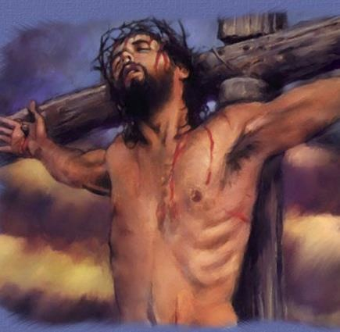

Slide 25
Jesus’ Second Work
Redemption of Firstborn Ephraim/Israel at Passover
He was the Passover Lamb
crucified on Passover - Nissan 14
“It is finished” at 3:00pm- the same time the priests sacrificed the last lamb and declared “It is finished”
He gave His own blood to re-open the door to the Covenant, thus redeeming the Firstborn from death again.

Slide 26
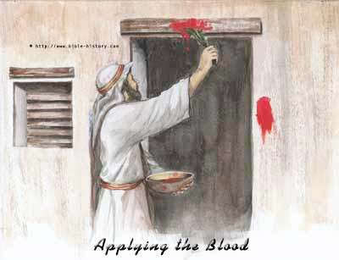
Passover
Redemption of the Firstborn

Slide 27
10th Plague: Death of Firstborn
Exodus 11:5 “and every firstborn male in the land of Egypt will die, from the firstborn of Pharaoh who sits on his throne to the firstborn of the servant girl who is behind the millstones, as well as every firstborn of the livestock.”
Exodus 12:23 ”For the LORD will pass through to smite the Egyptians; and when He sees the blood on the lintel and on the two doorposts, the LORD will pass over the door and will not allow the destroyer to come in to your houses to smite [you].”

Slide 28
The Blood of the Lamb
What does the blood save them from?
death of the Firstborn
By entering into the House, their Firstborn are preserved
The Redemption of the Firstborn!
This is the first step into the Covenant House

Slide 29
The Kingdom
Ephraim
Judah

Slide 30
The Kingdom
Ephraim
Judah

Slide 31
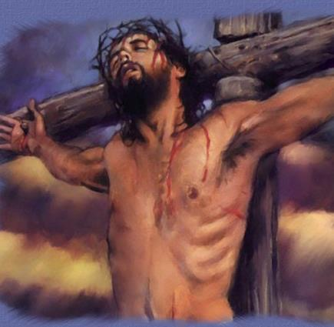
The Kingdom
Ephraim
Ephraim
Judah

Slide 32
The “Lamb”
Exodus 12:1-3 Now the LORD said to Moses and Aaron in the land of Egypt, "This month shall be the beginning of months for you; it is to be the first month of the year to you. "Speak to all the congregation of Israel, saying, 'On the tenth of this month they are each one to take a lamb for themselves, according to their fathers' households, a lamb for each household.

Slide 33
Lamb
Hebrew: “seh” one of a flock, a sheep or a goat
plural: “son”
“Behold the “son” of God who takes away the sins of the world.”
As the “lamb” he re-opened the Passover Door
As the “goat” he was the Yom Kippur sacrifice for sin

Slide 35
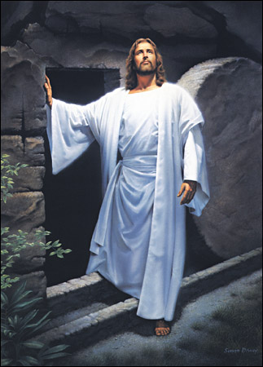
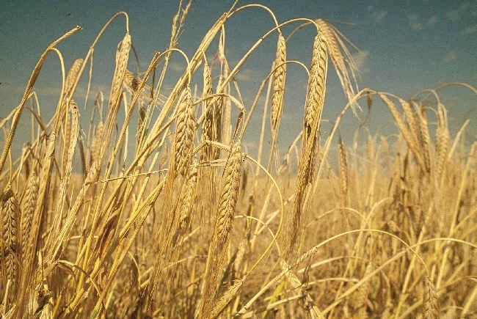
Jesus arose on Firstfruits

Slide 36
First fruits the day after the Sabbath of Passover
Leviticus 23: 15 “You shall count seven full weeks from the day after the Sabbath, from the day that you brought the sheaf of the wave offering. 16 You shall count fifty days to the day after the seventh Sabbath. Then you shall present a grain offering of new grain to the Lord.
Hebrew: “and you shall count for yourselves from the day after the Sabbath, from the day that you brought the sheaf (omer) of the wave offering seven Sabbaths complete there shall be.”

Slide 37
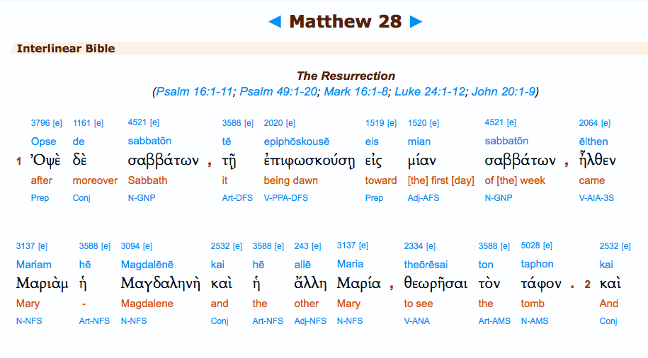
Eis mian sabbaton:
“on the first of the Sabbaths”

Slide 38
