Slide 1
Covenants of the Bible

Slide 2
The Covenants
Adam - Dominion and Authority
Noah - Preservation of the earth
Abraham, Isaac, Jacob - Covenant of Faith, Land, and Prosperity
Moses - Marriage Covenant
  Part two - Constitution of the Kingdom
David - Kingdom Covenant
Jesus - New/Renewed Covenant

Slide 3
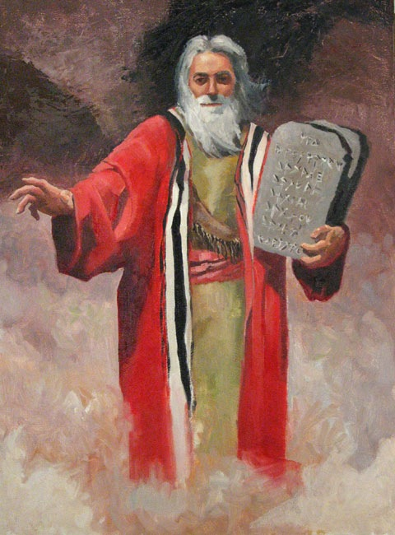
Covenant of Moses
Two Parts:
The Marriage
The Constitution

Slide 4
Review: Steps to Covenant
Passover - the doorway to Covenant
Crossing of the Red Sea - declared innocent
40 days in Wilderness - preparation
Mount Sinai - the wedding
Giving of Ten Commandments

Slide 5
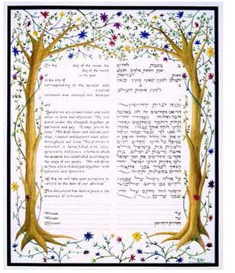
Torah: the Ketubah or wedding contract. The Covenant between YWHW and His people

Slide 6
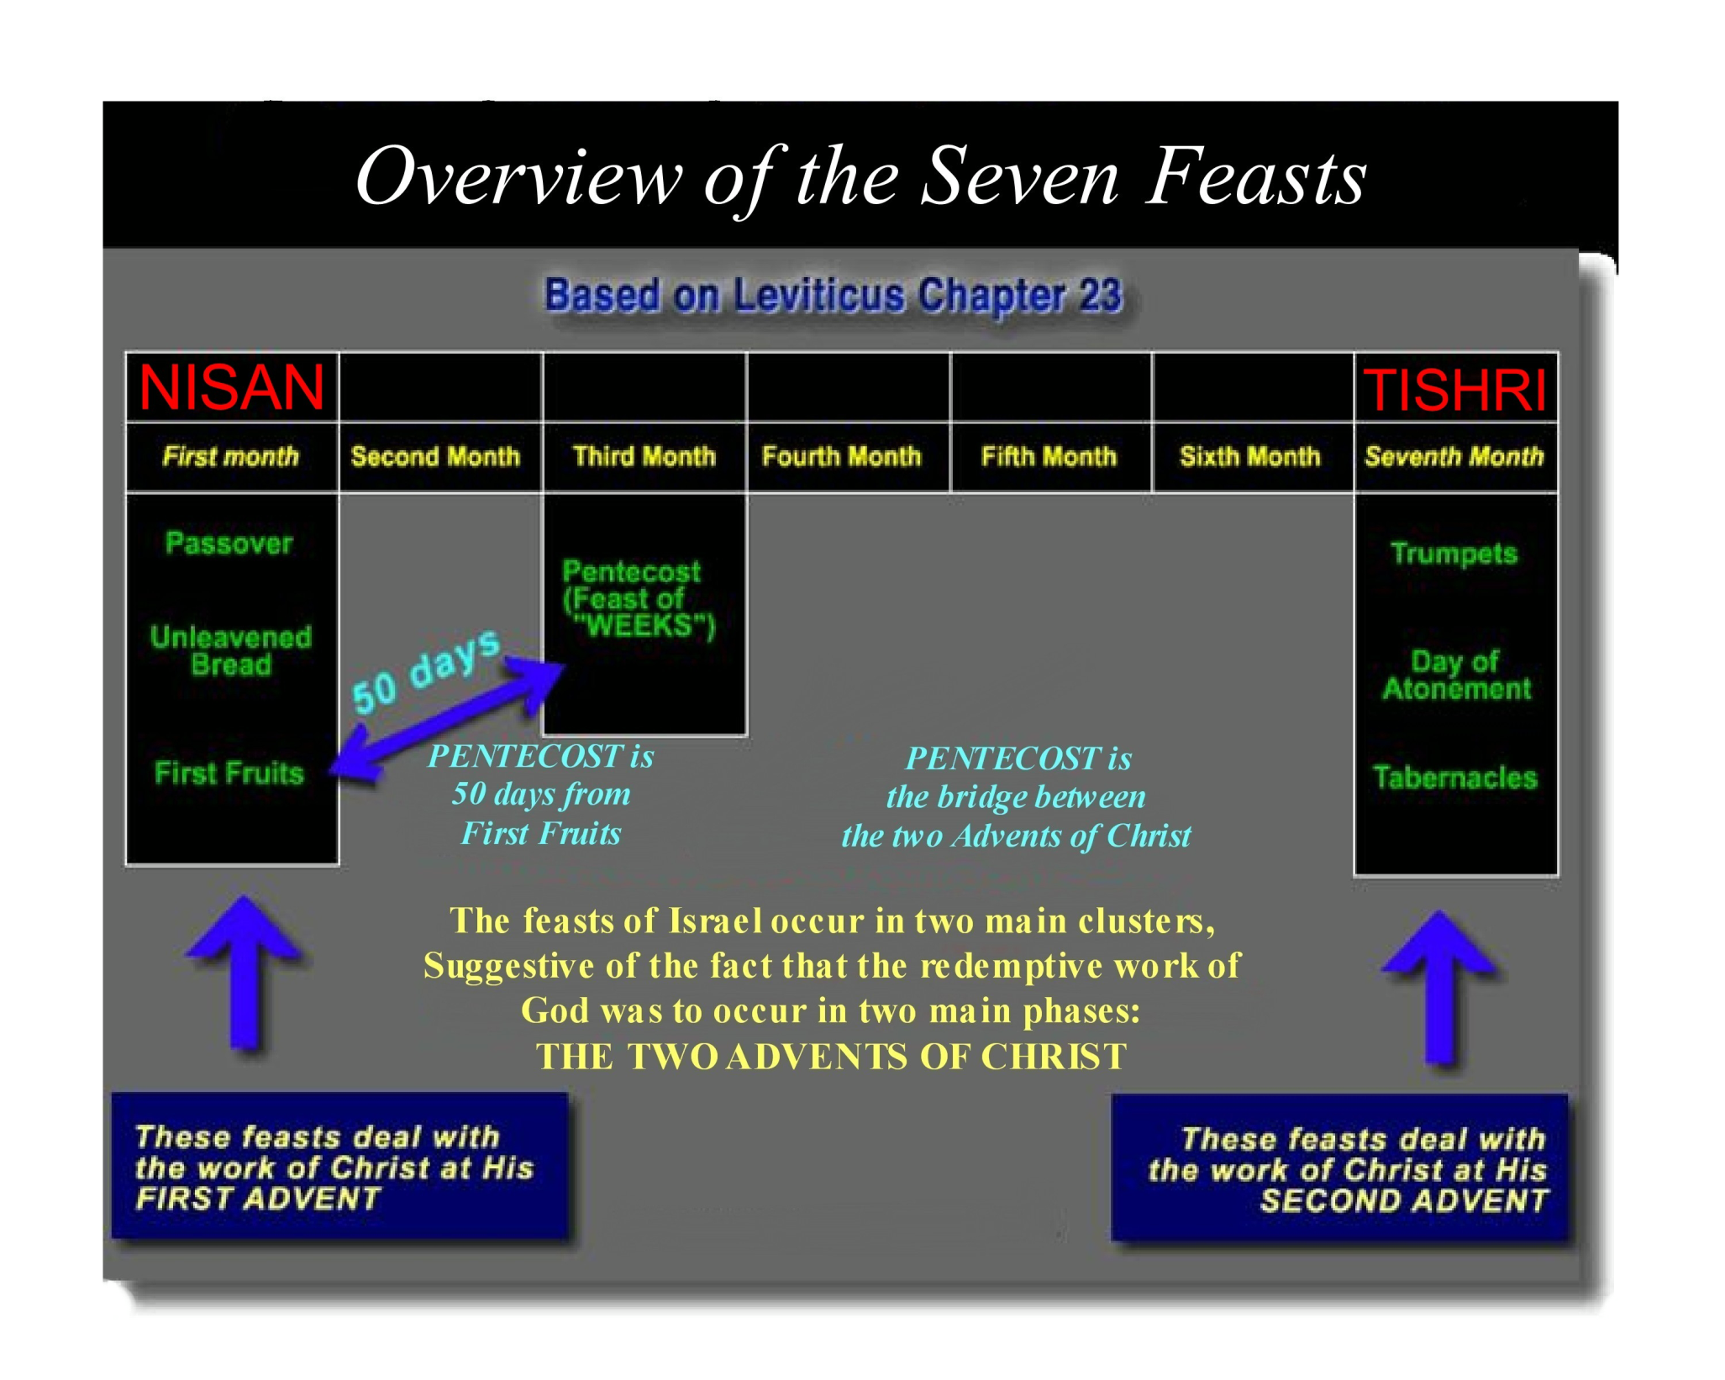
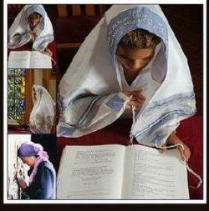

Slide 7
What did Jesus Say?
Jesus says all the Law hangs on these two commandments
  Deut 6:4,5 - the Shema: "Hear, O Israel! The LORD is our God, the LORD is one! "You shall love the LORD your God with all your heart and with all your soul and with all your might.”
  Lev 19:18 - love your neighbor as yourself

Slide 8
Love the LORD your God
I am YHVH your Elohim
Thou shall have no other gods before Me
Thou shall not take the name of YHVH your Elohim in vain
Remember to keep the Sabbath day, to keep it holy
Honor thy father and thy mother
Love your neighbor as yourself
Thou shall not kill
Thou shall not commit adultery
Thou shall not steal
Thou shall not bear false witness against thy neighbor
Thou shall not covet

Slide 9
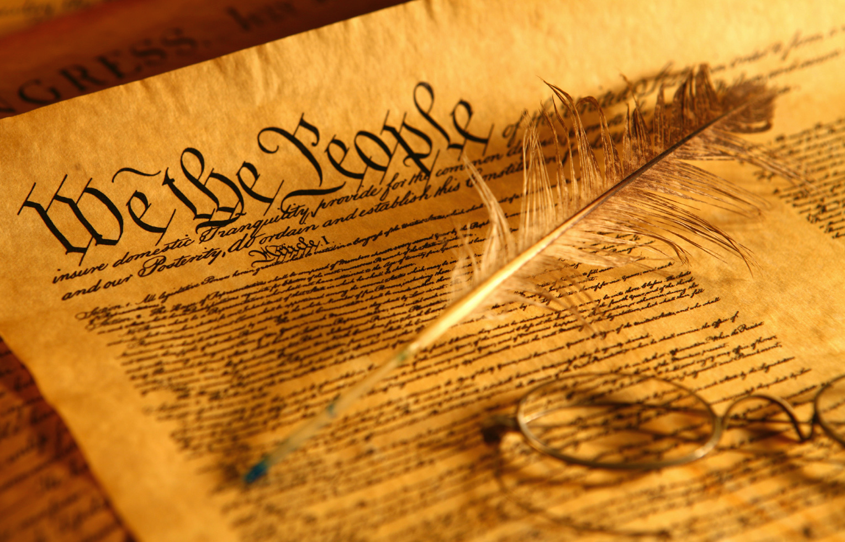
The Covenant of Moses
The Constitution of the Kingdom

Slide 10
The Covenant Established
Given at Sinai
Accepted by the people
Blood is shed - sacrificial system
Blessings and curses are established - Deuteronomy 28 & 29
Exchange of Names - Exodus 34:5-9
The Mark of circumcision
A covenant meal is shared

Slide 11

The Kingdom
The Citizens
The Constitution

Slide 12
The Kingdom Established
They are going to build the “Kingdom of Israel”
In Ancient Near East the king institutes a Constitution for the Kingdom
Torah is their Constitution
YHVH is their King

Slide 13
Elements of the Constitution
Principles of Worship - Sacrificial system and the Priesthood
King’s Responsibilities - to care for the people
  He brings equity and justice to them
  He gives them righteous rulings to bring order out of the chaos
  He is “enthroned” by entering into the “rest” of the Sabbath
Tithe instead of Taxes - to support the Temple and Priests
  The people bring a “tribute” to their King

Slide 14
Elements of the Constitution
Health and Sanitation - Dietary and Cleanliness laws, including managing disease
  Washing under running water
  Sewage system outside the camp
  Isolation of communicable disease
Military Requirements & War
  Humane treatment of prisoners
Capital Punishment
  Two or three witnesses
Judicial System

Slide 15
Judicial System
Moses instructs them on their court system
Those in authority were expected to protect the rights of the poor and weak in society.
“True justice” (see Lev 19:15) was required of kings, officials and local magistrates.
  the book of Judges and in prophetic literature (Is 1:23) describes a society in which “laws are enacted, but ignored”

Slide 16
Judicial System
The U.S. judicial system is based on this
Three types of Judges in the courts
  Judges of Three (a “Bet-din”)
  Judges of Twenty-three
  Judges of the Sanhedrin
Judges were to be "able men, such as [those who] fear God, men of truth, hating unjust gain" (Ex. 18:21) and "wise men, understanding and full of knowledge"
  Deut. 1:13; 1 Tim 3:8-10

Slide 17
Judicial System
Judges of Three - (local) monetary matters; theft, bodily injury, damage and compensation, rapists and defamers; lashes, sighting of the moon
  Our local court system
Judges of Twenty-three - (small Sanhedrin) Trial of Yeshua was illegal: it occurred at night by Rabbinical Priests NOT by The Great Sanhedrin. Capital offenses to be judged during the day
  Federal court
Judges of 71 - the Great Sanhedrin - highest court
  Supreme court

Slide 18
Immigration Laws
The Stranger or Foreigner
  temporary resident
  does not have the same rights as a citizen
  is to be taken care of and protected
The ger (גֵּר), the resident alien,
  lived more or less permanently in his adopted community
  applying for citizenship
  they learned the law of the Land

Slide 19
Purpose of the Constitution
So that they would prosper and live long in the Land
Lev. 20:22 “You are to observe all my regulations and rulings and act on them, so that the land to which I am bringing you will not vomit you out.”
Deut 11:8, 9 "You shall therefore keep every commandment which I am commanding you today, so that you may be strong and go in and possess the land into which you are about to cross to possess it; so that you may prolong your days on the land which the LORD swore to your fathers to give to them and to their descendants, a land flowing with milk and honey.

Slide 20
The Davidic Covenant

