Slide 1
Hebrew - The Aleph Bet
The Language of the messiah

Slide 2
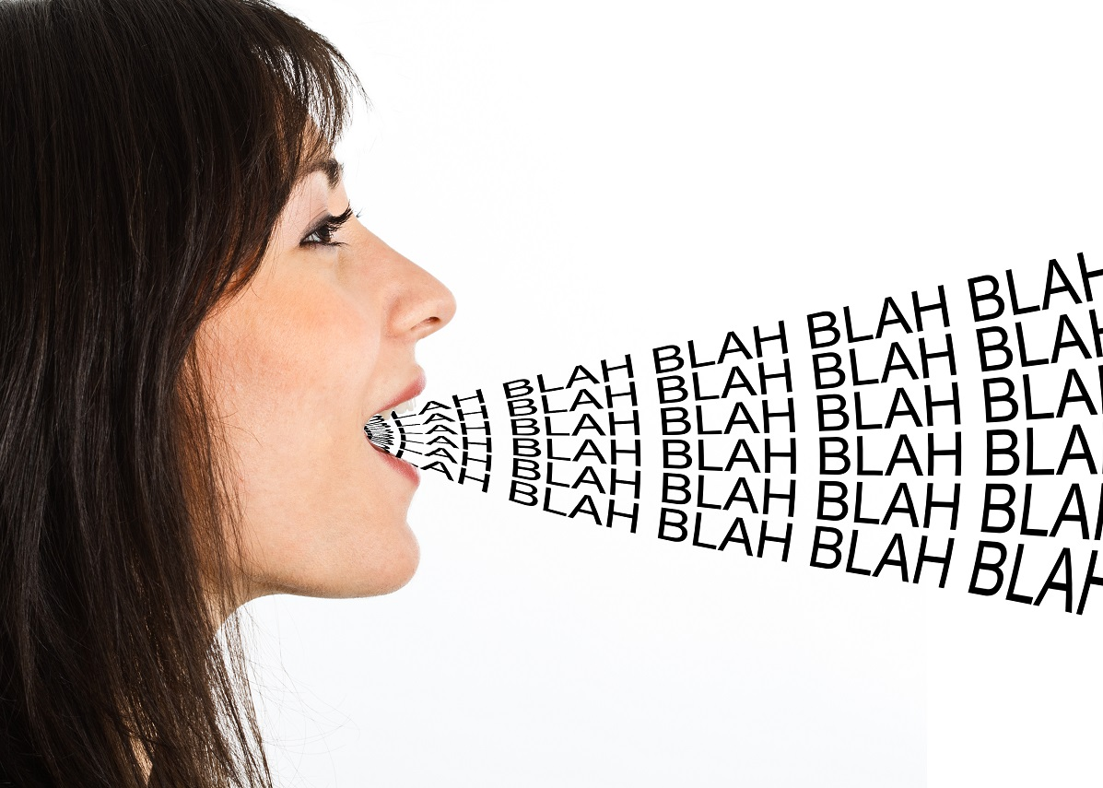
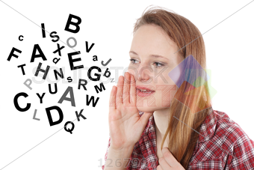
Language is how we communicate

Slide 3
But what if we don’t speak the same language…???

Slide 4
Hebrew The First and Last Language
The sages say that the world was created with the Hebrew Language
The earth was created through the spoken word
John 1: In the beginning was the Word
The Word was with God & was God - Jesus
All things were created through Him
The letters of the Aleph Bet are the building blocks of life

Slide 5
Hebrew The First and Last Language
Hebrew will be the language spoken in the Millennium
For then I will restore to the peoples a pure language, that they all may call on the name of the LORD, to serve Him with one accord. (Zephaniah 3:9 )
Hebrew was restored in Israel by Eliezer Ben-Yehuda
It is the only ancient language that has been restored as the official language of a nation.

Slide 6
“Buried within and behind the prophetic words and letters of the Hebrew text are layers upon layers of meaning, with multiple hints and allusions flying off in every direction.”

Slide 7
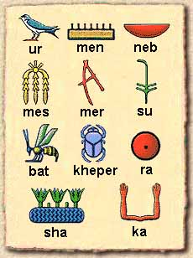
Paleo Hebrew
An ancient picture language
Similar to Egyptian Hieroglyphics

Slide 8
Paleo Hebrew
Used before and during the time of Moses
A Picture language
Each picture has a meaning
Each Letter has a numerical equivalent
There are both positive and negative meanings behind every letter

Slide 10
#1 Aleph – the Strong Leader
Sounds like our “ah”, sometimes “eh”
Often it is not pronounced – it is an intake of air
#1 – one and only, unique
The LORD is our God, the LORD is One
Ox, Strength, Leader
Ox: leadership of Israel, a sacrificial animal

Slide 11
#2 Bet– House, Family, “In”
House: two houses, the house of the covenant family
“In”: Beresit “In the beginning”
בְּרֵאשִׁ֖ית רֵאשִׁ֖ית בּ
Family: a family divided
#Two
Two families: Jew and Gentile
Two Kingdoms: Judah and Israel
Two Houses: Judah and Ephraim

Slide 12
#3 Gimel – Foot, Camel, Pride
Pronounced like a hard G
Camel: a bearer of burdens
The rich man who comes on the camel and kneels down to give gifts
Foot:
Positive – something you stand on
Negative – the foot is unclean in Eastern thought
Pride: to lift up (God or self)

Slide 13
#4 Dalet – Door, Move, Entrance
Door: tent door, an entrance to the Covenant House
Move: to walk in the path of Life
#Four – four corners of the earth, four winds of heaven, four directions
4th Commandment – the Sabbath rest
Rest:

Slide 14
#5 Hey – Behold, Reveal, Breath
Behold: “Look!”, to show importance
Reveal: Implies revelation, divine breath, light
Breath: to sigh, the “breath” of God
“Ha” – Look, behold, to draw attention to something important

Slide 15
#6 Vav– a Nail, to secure, to add
Pronounced like our letter V, W or U
Nail: The nails of the Cross; A tent peg
Hooks of the Tabernacle
A connector = our word “and”
#6 is the number of man
Man created on the 6th day
666 = the number of unholy “man”

Slide 16
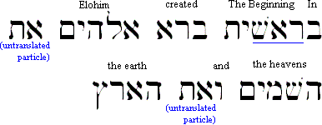

Slide 17
#7 Zayin–To Plow, a Weapon, Cut
Pronounced “tz”
Plow – it divides between 2 things; a harvest tool
Weapon – it defends the covenant
Cut – divides time
Zakar: to remember or bring to mind (with the idea of pricking or piercing
Also a male – another form of “man”
7 = wholeness, completion, blessing

Slide 18
#8 Chet – Wall, Fence, Separation
Wall or Fence – the “fence” of the Torah (Law) protects us from harm
Chabah: to hide as a place of refuge and safety חָבָה
8 = number of Grace, Wisdom, New Beginnings

Slide 19
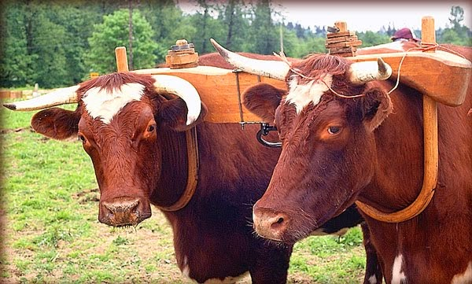
Chet: The Yoke of the Master
A discipleship term
Jesus said to take His yoke
He is the Rabbi and we are the Disciple

Slide 20
#9 Tet – A Snake Hidden in a Basket
A Basket… with a Snake…Aaaaa!
Reveals both good and evil
Tree of the Knowledge of Good and Evil
Snake: it twists and turns; deceptive
To Surround: ie “good”
ט֥וּב

Slide 21
Zakar, to remember
Also a male
Chasah, a refuge or place of hiding
Tabach, to slaughter
A sacrifice --- a man

Slide 22
#10 Yod – a Hand or arm, Work, Worship
Pronounced like our letter Y or “E”
Arm: the hand that reaches out
Applies to our Work (book of James)
Worship
Ten: 10 Commandments – our “work” and “Worship” to show our love for our Heavenly Father

Slide 23
God’s Name in Hebrew - YHVH
God’s Name = Jehovah = Yahovah = Yahweh = YHVH

Slide 24
Behold
The Nail
Behold
The Hand

Slide 25
The Aleph Bet

Slide 26
The Aleph Bet

Slide 27
#11 Kaf– Palm of the hand
Looks like the palm of a hand, or a crown
Palm: the palm blesses; the palm of “power”
To open: It opens heaven and calls forth the power of the Spirit onto the earth
Allow, or tame: it calms the chaos
Represents the number 20 (expectancy, redemption, waiting)

Slide 28
#12 Lamed – Shepherd's Staff
Represents the number 30
It represents Authority, to learn or to teach
Shepherd: The Good Shepherd!
Staff: It goads us to action
12 tribes, 12 disciples: all following the Shepherd who teaches
It is the tallest letter and is often written oversized in Torah scrolls

Slide 30
#13 Mem – Water, Chaos
Represents the number 40
Chaos Water = the Flood!
The Water of the Nations/Gentiles
Waves, peoples, nations, languages, tongues
40 days of testing in the Wilderness
40 years of travel in the Wilderness

Slide 31
#13 Mem – Water, Chaos
The “ocean” of Torah
40 Days of Repentance leading up to the Fall Feasts
We “immerse” ourselves in His Word
Open Mem = Truth Revealed
Closed Mem = Truth Concealed

Slide 32
#14 Nun – Seed, Fish, Life
Represents the number 50
Seed, fish, activity of life, an heir or son; action, to continue
50 = Jubilee year, Feast of Pentecost (50 days from Passover)
50 = the Holy Spirit who brings Life
Jesus chose Fishermen who He taught to “fish” for men

Slide 33
Sus – a horse. Can represent an army
Chasah, a refuge or place of hiding
Tabach, to slaughter
A sacrifice --- a man

Slide 34
#15 Samekh – Thorn, Support, Shield, Protect
Represents the number 60
Both positive and negative meanings
Shield: God’s support and protection. He is our Shield!
Thorn: to grab, hate, twist or turning
Sus “horse”. ס֔וּס
Can be an army to protect or an army to attack

Slide 35
#16 Ayin – An Eye; Watch; Experience
Represents the number 70
Eye: to see, understand, obey
Watch: to perceive; or to know by experience; to observe the signs of the times
The spiritual light of God. The eye is the window to the soul!
70 = Restoration

Slide 36
The Aleph Bet

Slide 37
#17 Peh – Mouth; Speak; Scatter
Has the sound of P or F
Represents the number 80 (strength in human life)
Mouth, to Speak: word, expression, speech, breath
To blow, scatter, commence
God’s commands come from His mouth. He created the world by speaking.
Our words have creative power

Slide 38
#18 Tsade – Man on his side; a Journey; Desire/need
Represents the number 90 (fullness of life)
Man on his side (representing need)
Man on his knees with hands elevated in praise and victory!
Fishing hook: to hunt, chase, catch, to fish for men
Tzaddik – the righteous, holy man

Slide 39
#19 Kuf or Qof – Sun, Behind, Time
Represents the number 100 (promise; move of the Spirit)
Sun: rising sun at the horizon, the East (East often refers to the Temple)
Behind: back of the head
Time: cycle of time, the end of the cycle, the cycle of the Feasts (Moed)

Slide 40
#20 Resh – Man’s Head; Authority; the First
Represents the number 200 (insufficient, not enough)
Man’s Head: the chief person, the man in authority, the “top”
First: the beginning, the sum
“the man is the Head (beginning) of the woman”
Negative: bitter, grieved, poor, last, afraid
#20: expectancy, redemption, waiting

Slide 41
#21 Shin – Teeth, Destroy, Separate
Represents the number 300
Teeth: to eat, something sharp, anything to do with eating and the mouth
Press/Destroy: to chew up
Separate: two, divide
Shekinah

Slide 42
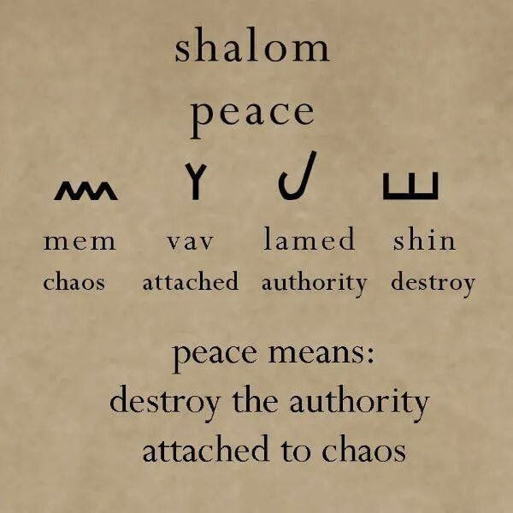
Shalom – Peace Nothing broken, nothing missing

Slide 43
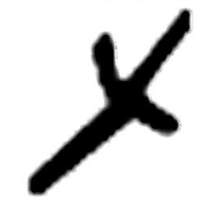
#22 Tav – a Cross, a Mark or Sign; Covenant
Represents the number 400
The ancient sign of the cross
A Mark or Sign: identifies locations used to mark out a location. Two crossed sticks were used to hang the family standard or banner.
Covenant: both the Old Covenant and the New Covenant

Slide 44
Covenant - berith or b’rit
The House of the Head Person extends the hand from the Cross

Slide 45
God’s Right Hand came to destroy sin by nailing it to the cross. When He comes, every eye will see Him and cry out “Yahweh is our Salvation”

Slide 46
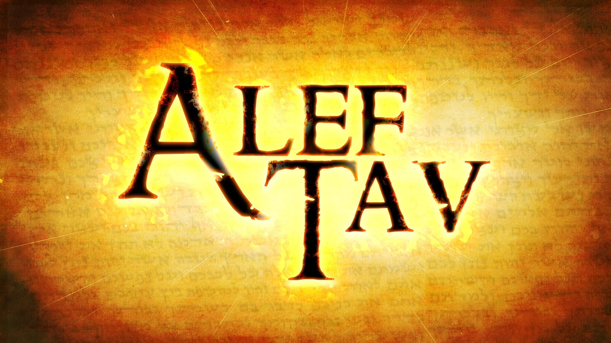
The Mystery of the

