Slide 1
Covenants of the Bible

Slide 2
Adam and Noah

Slide 3
The House where the Head (Person) gives his Hand as a Covenant sign

Slide 4
Seven Covenants
Adam - Dominion and Authority
Noah - Preservation of the Earth
Abraham - House, Family, Piece of Land
Isaac and Jacob - Wealth & Protection
Moses - Marriage Contract
David - Eternal Earthly Kingdom
Jesus - Renewed Covenant

Slide 5
Adamic Covenant
Dominion and Authority

Slide 6
Adamic Covenant
Dominion and Authority
Genesis 1 - the creation of the world
Day One: Light
Day Two: Sky (Dome of water)
Day Three: Dry Land and Oceans, grass, plants, trees
Day Four: Heavens (sun, moon & stars) for establishing God’s Calendar (Moed)
Day Five: Sea creatures, birds
Day Six: Animals, Humankind
Day Seven: Sabbath

Slide 7
“There was evening and morning, day one”
Evening and Morning
Hebrew: vayehi ere vayehi boker
Evening: “erev” עָ֫רֶב
Morning: “boker” בֹ֖קֶר
Can be translated: “chaos and order”
Yahweh was progressively making order out of chaos
“Life” = to create order out of chaos

Slide 8
Life and Death
Life: Chayyim חַיִּים֙
Death: Maveth מָ֫וֶת

Slide 9
Man Created Distinctly Different
"Let Us make man in Our image,
In Our likeness
God created man in His own image, in the image of God He created him; male and female He created them.
"Be fruitful and multiply, and fill the earth, and subdue it; and rule over the fish of the sea and over the birds of the sky and over every living thing that moves on the earth."

Slide 10
In His Image & Likeness
Elohim: אֱלֹהִים
root: eloah – singular
Elohim - plural
Adding the yod-mem creates a “plurality of greatness”
Context also implies that God is both male and female
Image: Heb “tselem” צֶ֫לֶם
Likeness: Heb “demut” דְּמוּת

Slide 11
Likeness
Likeness: Heb “demut” דְּמוּת
דְּמוּת
“The path securing a covenant over chaos”

Slide 12
God’s likeness
To be “in God’s likeness” is to be the “path” that guarantees life over chaos.
Elohim is the God of life, opposing death and destruction.
This shows that Adam is like God in his actions, not in his essence
human beings are not miniature gods, but they are capable of acting in ways similar to God when they walk according to the pathway that secures life.
Being human means acting according to God’s path to life.

Slide 13
Man’s Responsibility
To be like God in actions
Knowing His instructions (Torah)
what is permitted and what is not
and acting on it
Animals exhibit non-human behavior
they are not exhibiting God’s image
When sin entered the picture, humans began moving in a different direction
they rejected His path
they did not walk in life (order over chaos)

Slide 14
Image
Image: Heb “tselem” צֶ֫לֶם
צֶ֫לֶם
To desire to control or have authority over chaos

Slide 15
God’s Image
Being in His image is about “transferred authority” and order over what destroys.
To desire to control and have authority over chaos
Reflects the prime directive: “to be fruitful, multiply, subdue and steward” - all actions that require authority over chaos.

Slide 16
“If Genesis is anything, it is the proclamation of God’s authority over chaos. Genesis announces the God of order, the God who brings organization and purpose to the formless and void (Genesis 1:2). If human beings have anything in common with the Creator, it is the ability to bring order to chaos and exercise authority over structure.
Human beings are “like-ordering” beings. They reflect the divine image when they bring order to life in the house, the place God has provided for them to live.

Slide 17
Authority over what?
Authority over the Earth
It is authority in the house.
Our authority is limited
requires our connection to our Creator
We are to be a reflection of our Father
act like He acts, reflect His choices
Covenant: Berith - it starts with a house

Slide 18
Our responsibility is to do the “deeds & work” of the Covenant in the Head Person’s House.

Slide 19
The Creation is Finished
Genesis 2:1: Thus the heavens and the earth were finished along with everything in them.
God establishes the Sabbath
Sabbath is the sign that we believe Yahweh is our Creator
“Finished”: Hebr: “kalah
Also used for the word “Bride”
The Earth is His Bride, Adam tends the Bride

Slide 20
Division of Adam and Eve
Man was created as both male & female
God split the feminine from Adam
Adam was to guard the Torah (instructions) and listen to Yahweh
Ishah was to be Adam’s spiritual protector and provider
to watch, guard and warn Adam of danger
His “ezer kenegdo” - Guardian Angel
They worked together as Priests to administer authority over the garden

Slide 21
Man’s Responsibility
To have dominion - to rule as a shepherd/king
to use his stewardship skills
to extend God’s order and harmony into all creation
To be the Priest of the covenant house
a Priest understands His instructions, implementing and teaching them
To Subdue: extend his authority to turn chaos into order over the whole earth

Slide 22
The Fall
The Serpent deceived Ishah and she ate
Ishah gave to Adam and he ate
They no longer would live out of the tree of Life
“Life” = to create order out of chaos
They chose to live out of the tree of Knowledge of Good and Evil
deciding for themselves what was good and evil

Slide 23
Two Trees
Tree of the Knowledge of Good and Evil
Tree of Life

Slide 24
Results of Eating
Tree of Life
They will live in God’s ways and provision
Authority is theirs, under His authority
Living in God’s “house”
Tree of The Knowledge of Good and Evil
Adam will die - he doesn’t physically die
He loses a place in God’s covenant house
Life as defined by God comes to an end
He is thrust out into the world of his own making without the provisions of God

Slide 25
The Curse
God curses the serpent
God curses the ground
God does NOT curse Adam and Eve.
He describes the automatic consequence of their failure to obey
their lives will now experience “sorrow”
Adam opened the door to disaster (chaos) on the earth.

Slide 26
Living under the Wrong Tree
We determine for ourselves what is Good and Evil
We attempt to become our own authority
We try to become like the gods
We act as our own source of well-being
We create our own image - idolatry
The result is a return to Chaos

Slide 27
The Goal
To return the creation to this Eden state
The rest of the Bible pursues this course of restoration
God intends to bring His children back to the Garden of Covenant
Adam and Eve have their same assignments/gifts
Adam trying to establish dominion
Eve trying to guide and advise Adam

Slide 28
Noah Covenant
Preservation of the Earth

Slide 29
The Story – Genesis 6-9
The earth was corrupt and was filled with violence (“chamas”)
everyone was living out of the wrong Tree
doing what was right in their own eyes
God judged evil - a Covenant lawsuit
God preserved life (Noah)
He commanded Noah to build an ark
He established His covenant with Noah: Genesis 6 (1st time Br’it appears)

Slide 30
The Flood
Cleansing the earth
Restoring the Covenant House
Preserving Life
Reveals God’s guidelines for covenant life
Kosher - clean and unclean animals
The Biblical Calendar - His Feast Days
Sacrificial system - the Firstborn son is responsible to offer sacrifices

Slide 31
Noach (Noah): נֹ֫חַ
Life Protected

Slide 32
Ark = Tebah, “a box”
Revelation
House
Covenant
“The Covenant House Revealed”
The Ark was the Covenant House

Slide 33
Dimensions of Ark
300 Cubits
50 Cubits
30 Cubits
The shepherd staff will give life from the destruction

Slide 34
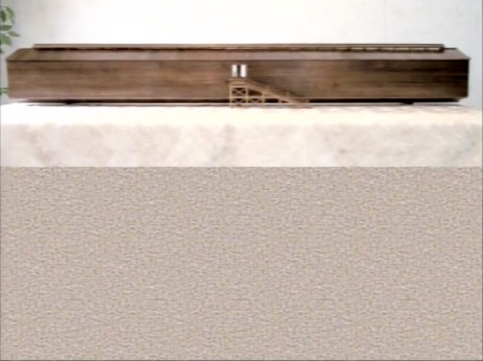
Dimensions:
150 Yards x 25 yards x 15 yards
450 feet long
75 feet wide
45 feet high
4.5 stories high!
Three stories/levels

Slide 35
Feasts seen in the Flood
The Flood started in the month of Hanukkah
It rained 40 days & nights - 40 days of Repentance before Fall Feasts
The ark came to rest on Firstfruits (when Yeshua rose from the dead)
The water dried up on Trumpets
The earth was completely dry on Hanukkah

Slide 36
Noah‘s Covenant
Genesis 8
God remembers His covenant
Genesis 9
“I will establish my covenant (br’it) with you that never again will all living beings be destroyed by the waters of a flood, and there will never again be a flood to destroy the earth.

Slide 37
Covenant of Preservation
God would never judge His creation with water again
future judgment will be with fire
water and fire were both used in judgment
Noah (the Firstborn) builds an altar and offers a sacrifice to confirm the covenant
He gave Noah and sons the assignment to “Be fruitful, multiply and fill the earth”

Slide 38
Three Commandments
Be fruitful, multiply and fill the earth
Do not eat blood - Kosher instruction
this is very important to God!
life is in the blood - do not ingest the life of the animal.
Kosher animals were “clean”. They were considered to be food for humans.
Unclean animals were not considered food.
Do not murder - shed human blood

Slide 40
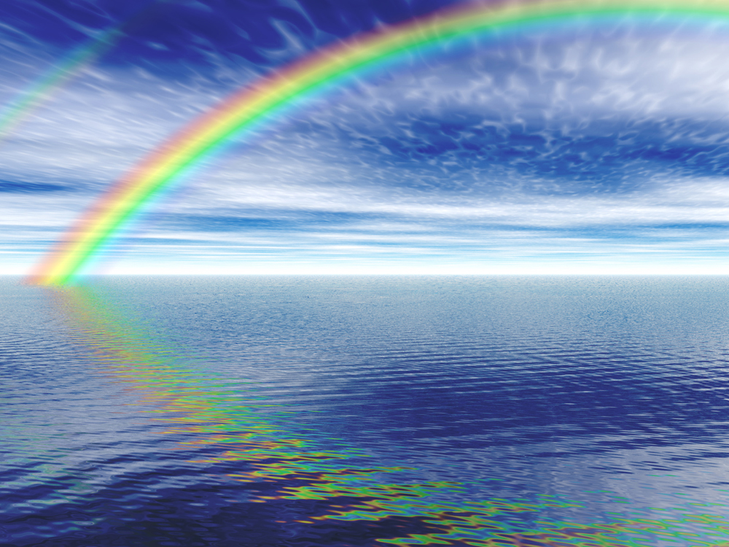
Promise of the Rainbow
Water + Light =

