Slide 1
Covenants of the Bible

Slide 2
The Covenants of the Bible
Scott and Teresa Bruce
Coffee With My Friends
www.CoffeeWithMyFriends.com
email: teresa@coffeewithmyfriends.com
Facebook
Syllabus Overview

Slide 3
Hebraic Thought vs.
Greek Thought
Hebraic study
70 layers of meaning
Types and Shadows
Prophetic foreshadowing
Repetitive events
history repeats itself
Hebraic Thought - Circular
Greek Thought - Linear

Slide 4
Cycle of Life
Sabbath – weekly
Rosh Chodesh (new moon) – monthly
Feasts – yearly
History - repeats
Sabbath
New Moon
Feasts
History

Slide 5
Intro to Covenant

Slide 6
What is a Covenant?
Covenant - Beriyth: to cut
“in the sense of cutting; a compact (made by passing between pieces of flesh); confederacy”
A common practice of the Ancient Near East
You “cut” a covenant
usually involved sacrifice of an animal
Also spelled Brit

Slide 7
The House where the Head (Person) gives his Hand as a Covenant sign

Slide 8
Covenant vs Contract
Covenant
sealed with blood so it is everlasting
given between two who are of equal strength
example: marriage
Contract
can be broken or annulled
given between a stronger and weaker partner
example: business contract

Slide 9
Covenant vs “Salvation”
Covenant
Enter into a “house”
Live a Torah Life with God
Living under the Blessings and Cursings
WDYS (What Did YHVH Say?
Salvation
Pray a prayer
Live your life with Jesus
As long as you have Jesus you are “saved” from sin
WWJD

Slide 10
God chose to make
a covenant with Man
By making a covenant with humanity, God would bind Himself to them and ask them to bind themselves to Him.
God’s purpose was blessing
He was looking for a Marriage to a Bride

Slide 11
Seven Covenants
Adam - Dominion and Authority
Noah - Preservation of the earth
Abraham - House, Family, Piece of Land
Isaac and Jacob - Wealth & Protection
Moses - Marriage Contract
David - Eternal Earthly Kingdom
Jesus - Renewed Covenant

Slide 12
The Steps of Covenant
Exchange of Coats
Exchange of Belts & Weapons
Cutting the Covenant
Walk of Blood
The Cutting - Sign on the Body
Pronouncing the Terms
Exchange of Names
Covenant Meal

Slide 13
Exchange of Coats/Robes
Exchange Identity
Exchange outer coats
Each gave the other their “all”

Slide 14
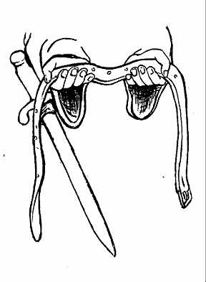
Exchange of Belts & Weapons
Strength and Assets
Exchange of Protection against enemies
Promised to come to each others’ aid if attacked

Slide 15
Cutting the Covenant
Animal Sacrifice
Could be one or multiple animals
Special type of cut down the middle
The animal is then laid out with a trough down the middle
The blood runs through the trough

Slide 17
The Walk of Blood

Slide 18
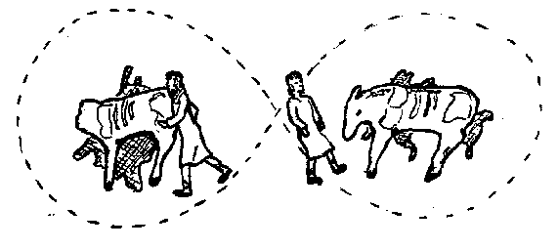
Walk of Blood
Partners face away from each other
Walk in a figure eight
Make their declarations of Covenant

Slide 19
The Cutting
The two would cut their hands or wrists
Mingle their blood
Raise their hands together
Rub ashes into the wound to make a permanent mark
“I have inscribed you on the palms of my hands.” Is 49:16

Slide 20
Pronouncing the Terms
The Terms of the Covenant
What each party brings to the joining
each brings their area of strength
Blessings and Cursings
Blessings when you keep the covenant
Cursings when you break the covenant
The two groups entered into “oneness”
Some tribes included a “Peace Child”

Slide 21
Exchange of Names
Each would take part of the other’s name
Abram + YAHweh = AbrAHam
“The God of Abraham”

Slide 22
Covenant Meal
Includes bread and wine or grape juice
The partners feed each other
“As you ingest this bread/wine, you are ingesting me.”
Bride and Groom feeding each other wedding cake.

Slide 23
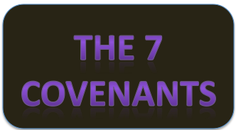
Next Week

