Slide 1
Blood Covenant

Slide 3
The Steps of Covenant
Exchange of Coats
Exchange of Belts & Weapons
Cutting the Covenant
Walk of Blood
The Cutting - Sign on the Body
Pronouncing the Terms
Exchange of Names
Covenant Meal
Plant a Tree or Set up a Stone or Altar

Slide 4
The Covenants
Adam - Dominion and Authority
Noah - Preservation of the earth
Abraham, Isaac, Jacob - Covenant of Faith, Land, and Prosperity
Moses - Marriage Covenant
David - Kingdom Covenant
Jesus - New/Renewed Covenant

Slide 5
Abrahamic Covenant
Foundational to our Faith walk
Covenants build on each other
  each Covenant reveals another layer
  each Covenant expands the promise
Abraham - a covenant of Faith (Trust)

Slide 6
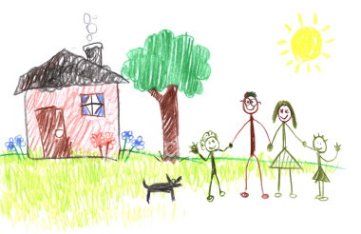

Slide 7
Abraham, Isaac, Jacob
The covenant is made to
  each one individually
  all three as a whole
The promise MUST go through this lineage - the Firstborn (of promise)
The promise is made to Abram, it is manifested through each of them

Slide 8
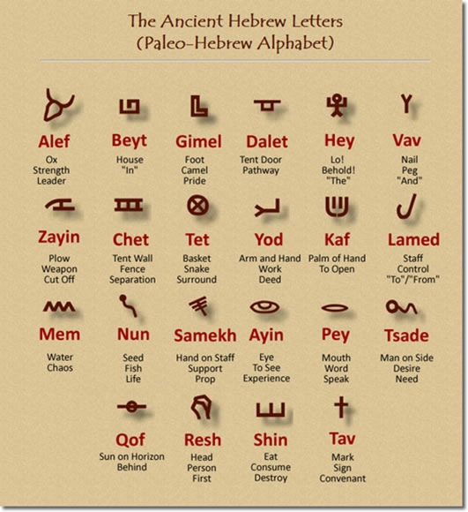
Abram
Abram - “Exalted father”
Ab - Father: “Abba”
Rum: to be high or exalted, rise
אַבְרָ֔ם

Slide 9
Who was Abram?
Firstborn son of Terach
Responsibilities of the Firstborn
  He was to be the Priest of the family
    intercessor
    mediator
  To manage the resources so he could take care of the family
    to lead the family as it’s Head (like a King)
  To build altars and offer sacrifices to God
    only the Firstborn could do this

Slide 10
Progression of the Covenant
The Promise - Genesis 12:1-3
  I will make you a great nation
  I will bless you and make your name great
  You are to be a blessing
  All the families of the earth will be blessed
  Abram builds an altar - confirms the promise
They go into Egypt – Prophetic Foreshadow
  Sarai the bride is taken by Pharaoh
  They are delivered out with plagues on Egypt

Slide 11
Progression of the Covenant
Wealth, Land and Descendants - Genesis 13
  Wealth - 13:2
  Land - 13:14-15
  Descendents - 13:16-17
  Abram builds an altar
Abram was given a Land Grant
  a “royal grant” covenant common in ancient Near Eastern cultures
  it is a gift of land and dynasty
  prominent in the Suzerain-Vassal relationship
Notes:
The covenants with Abraham and with David are modelled on the "royal grant" so common in the ancient Near East. Gift of land and dynasty, the subjects of the Abrahamic and Davidic covenants, are most prominent in the suzerain-vassal relationship. Like the royal grant in the ancient Near East so the covenants with Abraham and David are gifts bestowed upon individuals who excelled in serving loyally their masters.

Slide 12
Suzerain - Vassal Relationship

Slide 13
Progression of the Covenant
Melchizedek Priest confirms the Covenant - Gen 14:18-20
  meets Abram at Shalem - “Shalom (Peace)”
  Blesses Abram
  Abram tithes him a tenth of everything
Malki - Tzedek = is a Position, not a Person
Melek Tzaddik = a righteous king
The Melchizedek Priest when Abram was alive was Shem

Slide 14
The Melchizedek Priesthood
One who has the position of Firstborn, High Priest, and King
  able to rule and reign others
  a kinsman redeemer
  a faithful son
  willing to lay down his life for others
He has priestly rights and receives tithes
Must be the oldest firstborn son, living on the earth who had the leadership position

Slide 15
Progression of the Covenant
Protection - Genesis 15
  A Suzerain offers protection to the Vassal king
  He exchanges weapons with him and promises his sword
Abraham Believes - Genesis 15

Slide 16
Progression of the Covenant
The Walk of Blood - Genesis 15
  They determine the Terms of the Covenant
  They seal it with a blood sacrifice
  They walk between the pieces

Slide 17
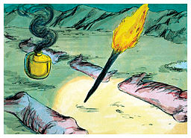

Slide 18
Progression of the Covenant
The Walk of Blood - Genesis 15
Exchange of Names - Genesis 17
The Mark of Covenant: Circumcision - Genesis 17
Exchange of names - Gen 17
Planting of a tree - Genesis 21
Exchange of sons (Peace Child) - Gen 22

Slide 19
Isaac
Isaac - the firstborn of promise
His name means “Laughter”
Prophetic Foreshadow
  The son of promise
  He is the sacrificed son (Peace Child)
  He is the “Bridegroom” like Yeshua
The covenant promise is passed through him rather than Ishmael

Slide 20
Jacob
Ya’akov - “he catches by the heel, he supplants”
The Covenant promise is passed through him rather than Esau - Gen 28
  He sets up a pillar in Bethel (Jacobs Ladder)
Jacob builds an altar – Gen 35
YHVH changes his name to Israel
  - Gen 32

Slide 21
The Name Israel
“One who Contends”
“A Powerful Prevailing Prince”
“A Soldier of Yahovah”
“One Who Rules With the Almighty”
“He Will Rule As God”

Slide 22
The Promise of the Father
Abraham - Father of Many Nations
Isaac - Laughter
Israel - He Will Rule As God
The lineage MUST go through all three to establish this covenant.
“Blessing of the Firstborn” by Promise or Faith, not by birth order

Slide 23
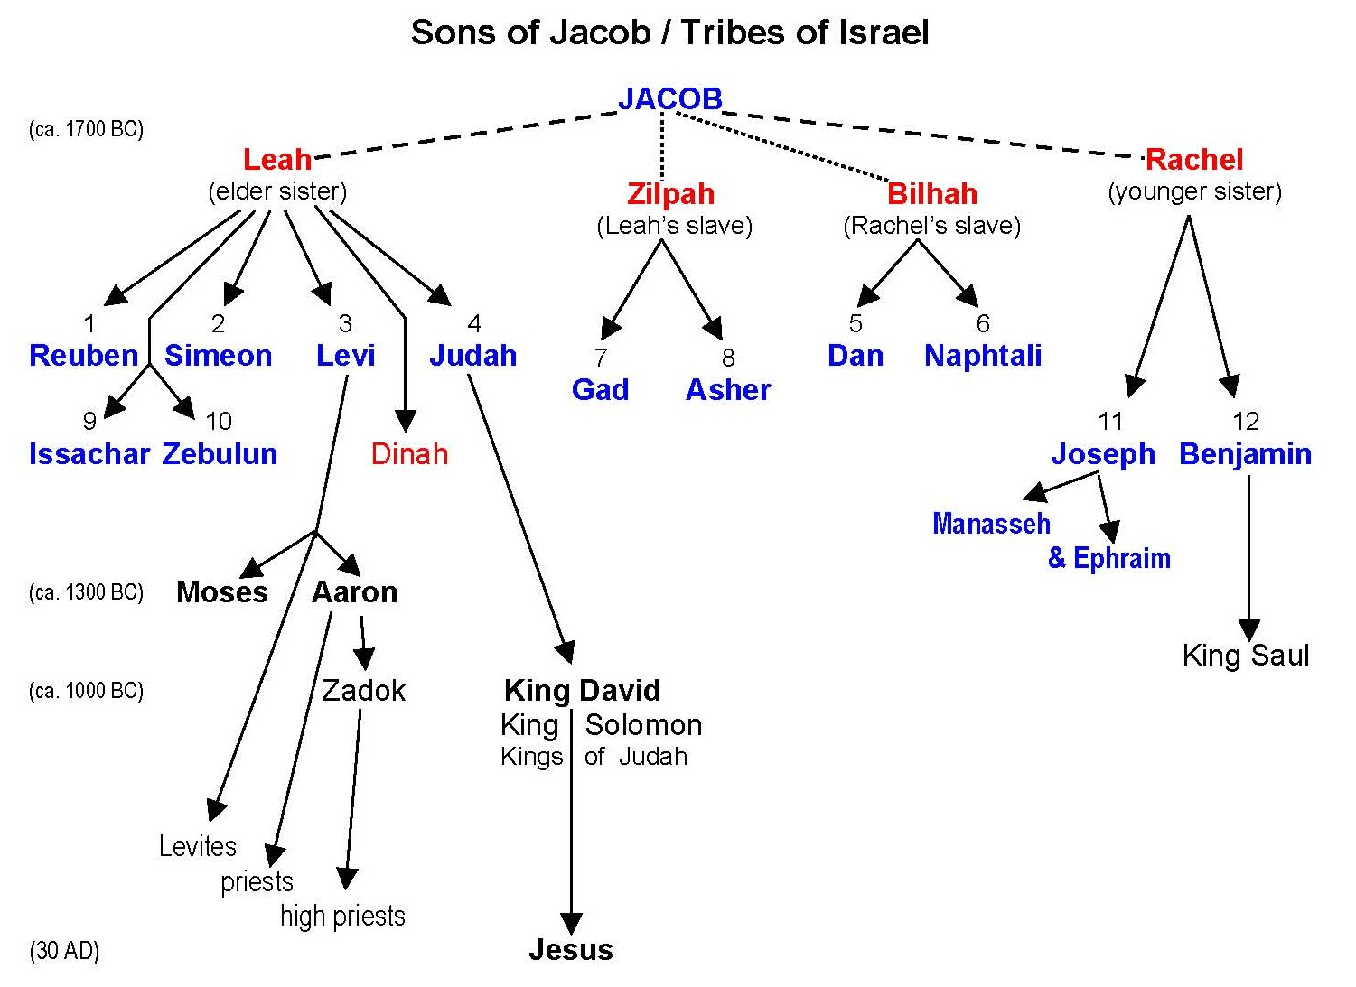
Melchizedek Priesthood
Priesthood
Kingship
Firstborn
House of Ephraim

Slide 24
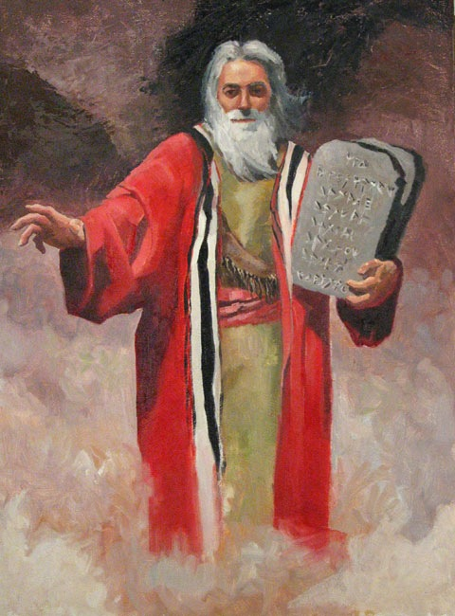
Next Week…
“The Mosaic Covenant

