Slide 1
The Restoration

Slide 2
Numbers: B’Midbar
In the Wilderness
בְּמִדְבַּ֥ר

Slide 3
Hukkat (Regulation)

Slide 5
28 years of Judgment and Harvest
Jacob’s Troubles
Division of “cattle”: sheep and goats
Fat cows: “parah”
The Harvest: “fat” (easy) & “shriveled” (hard)
#1: September 30, 2000
to
September 13, 2007
#2: September 13, 2007
to
September 24, 2014
#3: September 24, 2014
to
September 7, 2021
#4: September 7, 2021
to
September 30, 2028
September 30, 2000
Beginning of the War Cycles
September 30, 2028
End of the War Cycles
Four Blood Moons

Slide 6
Red Heifer
A young red female cow
Perfectly red hair with no defects
Has never borne a yoke
Is sacrificed on the Mount of Olives
It is facing the doors of the Temple
The person doing the sacrifice does not have to be a priest
The body is completely burned to ash
with cedar wood, hyssop and scarlet yarn
The ashes are mixed with “living water”
from the pool of Siloam
young priests who are “virgins” are the ones to mix the ashes
these are children who are raised from birth in the Temple

Slide 7
Red Heifer
A young red female cow
Red = sin
Female cow = Israel (all 12 tribes)
Has never borne a yoke
Yoke = man’s dogma of religion
Is sacrificed on the Mount of Olives
Some suggest Yeshua was crucified on Mt of Olives
The body is completely burned with
Cedar wood - humanity
Hyssop = healing
Red Yarn = sin
Mixed with water = the Holy Spirit

Slide 8
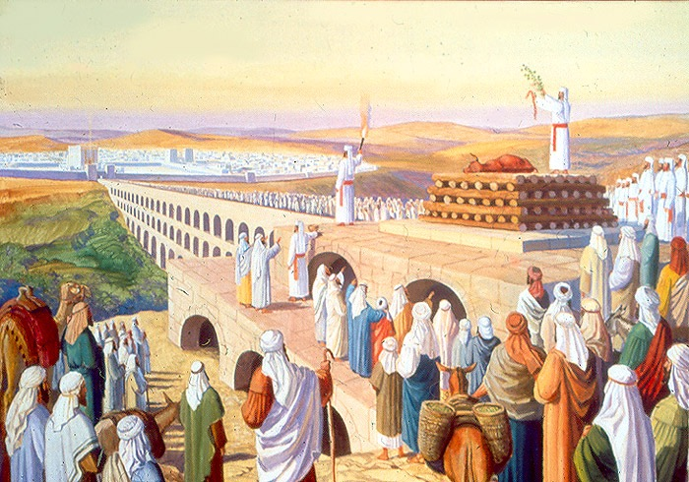

Slide 10
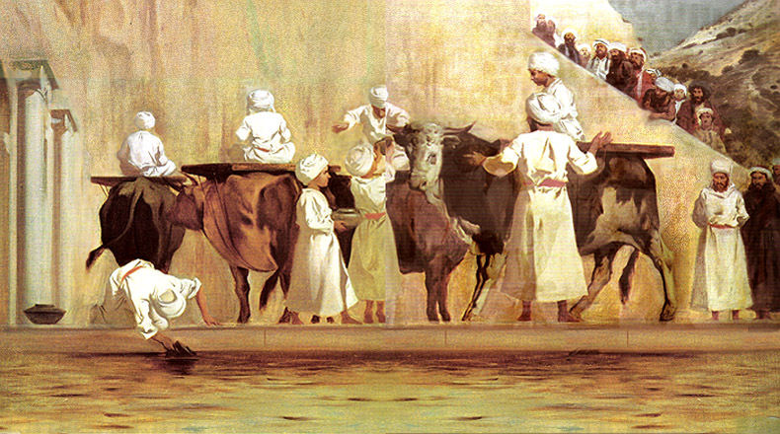

Slide 11
Ashes to Purify
To purify those who are unclean due to touching a dead body
Or if a person dies in their tent/house - everything in the place is unclean
On the third and seventh days
The water is sprinkled on the person with hyssop
On the seventh day he will wash his clothes and himself and be clean
The person who sprinkles them is also unclean until evening
This water/ash mixture was called the “Waters of Separation” or the “Waters of the Sin Offering,” and in Hebrew, han’niddāh.

Slide 12
Cleansing from uncleanness in the Restoration
Mark 5 - Yeshua heals the woman with the “issue of blood”
She is unclean for 12 years with niddah that doesn't end
She takes hold of the corner of his tallit (wings: kanaph)
Malachi 4:2 “2"But for you who fear My name, the sun of righteousness will rise with healing in its wings; and you will go forth and skip about like calves from the stall.”

Slide 13
Resurrection of the Temple and Priesthood
Mark 5 - Yeshua resurrects a 12-year-old girl
Daughter of Yairus: from Yair: "he enlightens,”; root word: "or" which is "light".
Refers to the Temple and Priesthood which bring light to the people
A daughter often refers to the Temple in ANE
Yeshua says “Talitha, kumi” (young girl, arise)
Talitha: from Hebr taleh “a lamb” or…
Hebr. naarah “a girl (from infancy to adolescence)”
Story of the rape of Dinah = rape of the Temple

Slide 14
Ashes are kept in 3 places:
One portion was stored on the Mt of Olives for use by the Kohanim
One portion was kept in the Cheil, next to the wall of the courtyard, for safe keeping when the Messiah returns.
The third portion was divided up among the twenty-four courses of the priests. These ashes would be used for purifying the people.
This purification ceremony, of sprinkling the ash/water mixture, might well be a precursor for the Messiah’s return, the ingathering of the exiles to the land, the resurrection of the dead, and the final redemption.

Slide 15
Death of Miriam Water from the Rock Serpent on a Pole

Slide 21
Miriam Dies
Tzin Desert: “a crag of a rock” צִן
The “plow or weapon that divides Life”
Miryam dies and is buried in Kadesh
Kadesh: from qodesh “holy, set apart”
Miryam: from meri: “rebellion”; root Marah: “bitterness”
So Rebellion from Bitterness dies in the holy set- apart place in the crag of rock that divides life.
Miryam מִרְיָם

Slide 22
Miriam Dies
Flip Side!
The Rabbis teach that while Miriam was alive, the people were sustained by a miraculous well of water that was connected to Miriam
When she died, the water stopped
“The water from the Head Person providing assistance in the chaos”
Moses and Aaron must provide water from another source

Slide 23
Water From the Rock

Slide 24
Water from the Rock
Rock: sela: a crag, cliff; From an unused root meaning to be lofty; a craggy rock, literally or figuratively (a fortress), strong hold. סָ֫לַע
Yah is our Rock and fortress
Yeshua is our spiritual Rock who gives living water
Moses and Aaron were supposed to speak to the Rock
They struck it instead - twice!
The Leaders Split the Rock!
Aaron dies. He and Moses are not allowed in the Land.
Numbers 18: Moses and Aaron bear the guilt of the congregation

Slide 25
Bronze Snake on a Pole
Fiery Serpents: hannehasim hasserapim
Serpent: nachash; root: to learn by experience
Fiery: seraph - from saraph: burning, i.e. (figuratively) poisonous (serpent); specifically, a saraph or symbolical creature (from their copper color)
Serpent = lashon horah, “evil speech"
Moses made a bronze snake and put it on a pole “nes”
Yeshua said He would be lifted up - John 3:14

Slide 26
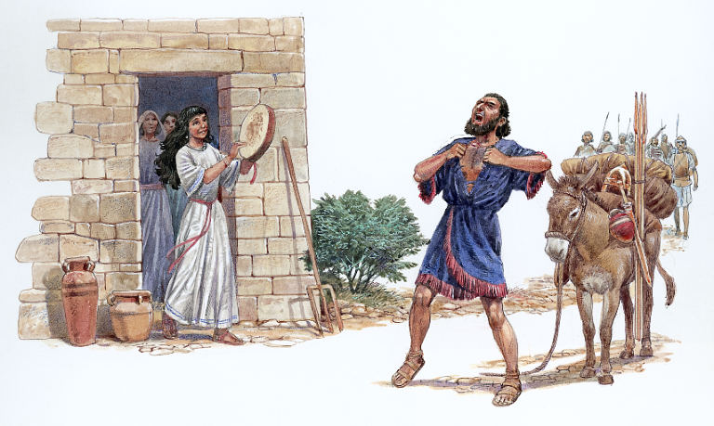
Jephthah Judges 11

